Slide 1

Faculty of Applied Engineering and Urban Planning
Civil Engineering Department
Dr. Eng. Mustafa Maher Al-tayeb
2 Semester 2022/2023
Probabilistic and Statistical

Slide 2
Probabilistic and Statistical Techniques
Chapter 5 (part 1) Probability Distribution
Notes:
2

Slide 3
Overview
Probabilistic and Statistical Techniques
This chapter will deal with the construction of
discrete probability distributions
by combining the methods of descriptive statistics presented in Chapter 2 and those of probability presented in Chapter 3.
Probability Distributions will describe what will probably happen instead of what actually did happen.
Notes:
Emphasize the combination of the methods in Chapter 3 (descriptive statistics) with the methods in Chapter 4 (probability).
Chapter 3 one would conduct an actual experiment and find and observe the mean, standard deviation, variance, etc. and construct a frequency table or histogram
Chapter 4 finds the probability of each possible outcome
Chapter 5 presents the possible outcomes along with the relative frequencies we expect
Page 200 of Elementary Statistics, 10th Edition

Slide 4
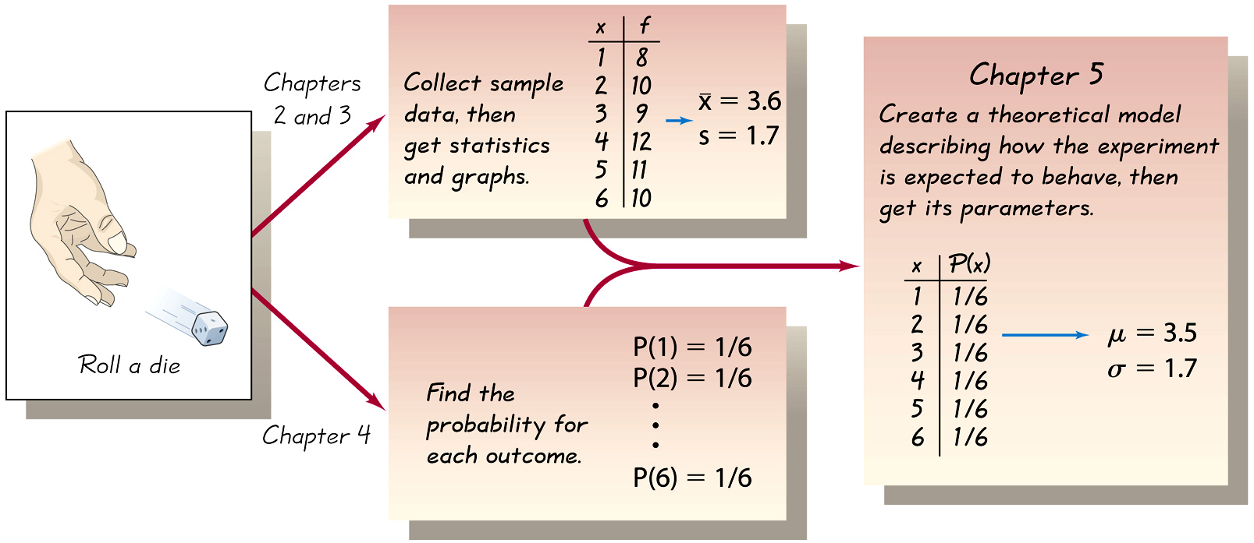
Probabilistic and Statistical Techniques
Combining Descriptive Methods
and Probabilities
In this chapter we will construct probability distributions by presenting possible outcomes along with the relative frequencies we expect.
Notes:
page 200 of Elementary Statistics, 10th Edition

Slide 5
Probabilistic and Statistical Techniques
Random Variables

Slide 6
Probabilistic and Statistical Techniques
Key Concept
This section introduces the important concept of a probability distribution, which gives the probability for each value of a variable that is determined by chance.

Slide 7
Definitions
Probabilistic and Statistical Techniques
Random variable
a variable (typically represented by x ) that has a single numerical value, determined by chance, for each outcome of a procedure
Probability distribution
a description that gives the probability for each value of the random variable; often expressed in the format of a graph, table, or formula
Notes:
page 201 of Elementary Statistics, 10th Edition

Slide 8
Definitions
Probabilistic and Statistical Techniques
Discrete random variable
either a finite number of values or countable number of values, where “countable” refers to the fact that there might be infinitely many values, but they result from a counting process
Example: The number of girls among a group of 10 people
Notes:
This chapter deals exclusively with discrete random variables - experiments where the data observed is a ‘countable’ value. Give examples.
Following chapters will deal with continuous random variables.
Page 201 of Elementary Statistics, 10th Edition

Slide 9
Probabilistic and Statistical Techniques
Probabilistic and Statistical Techniques
Probabilistic and Statistical Techniques
Definitions
Continuous random variable
infinitely many values, and those values can be associated with measurements on a continuous scale in such a way that there are no gaps or interruptions
Example: The amount of water that a person can drink a day ; e.g. 2.343115 gallons per day
Notes:
This chapter deals exclusively with discrete random variables - experiments where the data observed is a ‘countable’ value. Give examples.
Following chapters will deal with continuous random variables.
Page 201 of Elementary Statistics, 10th Edition

Slide 10
Examples
Probabilistic and Statistical Techniques
Identify the given random variables as being discrete or continuous:
The no. of textbooks in a randomly selected bookstore
The weight of a randomly selected a textbook
The time it takes an author to write a textbook
The no. of pages in a randomly selected textbook

Slide 11
Probabilistic and Statistical Techniques
Example:
Discrete random variable with a finite number of values
Let x = number of TVs sold at the store in one day,
where x can take on 5 values (0, 1, 2, 3, 4)

Slide 12
Probabilistic and Statistical Techniques
Example:
Discrete random variable with an infinite sequence of values
Let x = number of customers arriving in one day,
where x can take on the values 0, 1, 2, . . .
We can count the customers arriving, but there is no
finite upper limit on the number that might arrive.

Slide 13
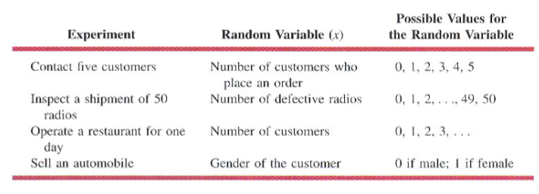
Examples of Discrete Random Variables
Probabilistic and Statistical Techniques

Slide 14
Probabilistic and Statistical Techniques
Continuous Random Variable Examples
Experiment | Random Variable (x) | Possible Values for x
Bank teller | Time between customer arrivals | x >= 0
Fill a drink container | Number of millimeters | 0 <= x <= 200
Construct a new building | Percentage of project complete as of a date | 0 <= x <= 100
Test a new chemical process | Temperature when the desired reaction take place | 150 <= x <= 212

Slide 15
Requirements for Probability Distribution
Probabilistic and Statistical Techniques
where x assumes all possible values
0 ≤ P(x) ≤ 1
for every individual value of x
Notes:
Page 203 of Elementary Statistics, 10th Edition

Slide 16
Examples
Probabilistic and Statistical Techniques
Does P(x) = x/5 ( where x can take on the values 0 , 1 , 2 , 3) Describe a probability Distribution
Solution:
To be a probability distribution P(x) must satisfy the two requirements, First is
P(0) +P(1) + P(2) + P(3) = 0 + 1/5 + 2/5 + 3/5 = 6/5
Because the first requirement is not satisfied, we conclude that P(x) given in this example is not a probability distribution

Slide 17
Examples
Probabilistic and Statistical Techniques
Does P(x) = x/3 ( where x can take on the values 0 , 1 , 2)
Describe a probability Distribution?
Solution:
To be a probability distribution P(x) must satisfy the two requirements, First is
P(0) +P(1) + P(2) = 0 + 1/3 + 2/3 = 3/3 = 1
Each of the P(x) values is between 0 and 1
Because both requirements are satisfied, P(x) function given a probability distribution

Slide 18
Probabilistic and Statistical Techniques
Discrete Probability Distributions
Using past data on TV sales, …
a tabular representation of the probability
distribution for TV sales was developed.
Number
Units Sold of Days
0 80
1 50
2 40
3 10
4 20
200
x f(x)
0 .40
1 .25
2 .20
3 .05
4 .10
1.00
80/200

Slide 19
Probabilistic and Statistical Techniques
Discrete Probability Distributions
Graphical Representation of Probability Distribution
0.50
0.40
0.30
Probability
0.20
0.10
0 1 2 3 4
Values of Random Variable x (TV sales)

Slide 20
Example: Dicarlo Motors
Probabilistic and Statistical Techniques
Consider the sales of automobiles at Dicarlo Motors
we define x = no of automobiles sold during a day
Over 300 days of operation, sales data shows the following:

Slide 21
Probabilistic and Statistical Techniques
Example: Dicarlo Motors
No. of automobiles sold | No. of days
0 | 54
1 | 117
2 | 72
3 | 42
4 | 12
5 | 3
Total | 300

Slide 22
Probabilistic and Statistical Techniques
Example: Dicarlo Motors
x | f(x)
0 | .18
1 | .39
2 | .24
3 | .14
4 | .04
5 | .01
Total | 1.00

